Slide 1
ANTENNA DESIGN CONTEST SUBMISSION
Dual-Band 4-Port MIMO Antenna
A high-isolation mimo antenna 915 MHz Sub-GHz IoT/LoRa connectivity with 2.4 GHz WLAN/ISM links on a single compact platform
Akash G · T Aakash · Rakshith Kumar · Dr. Usha Kiran Kommuri
Department of Electronics and Communication Engineering · VIT Chennai

Slide 2
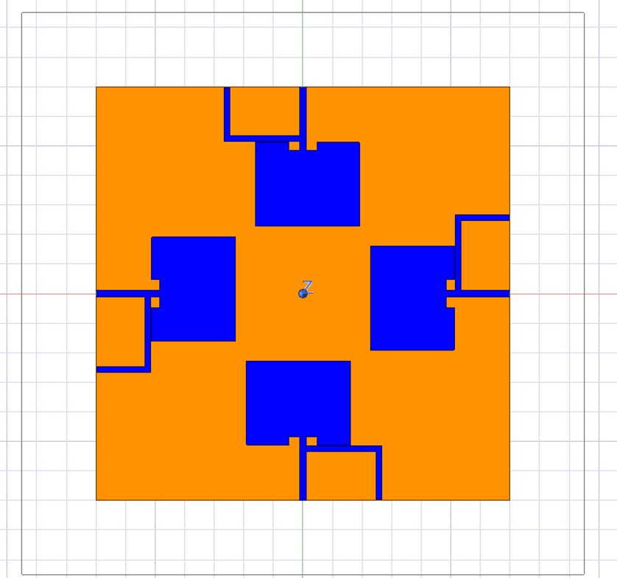
INTRODUCTION
Introduction
Why a dual-band, high-isolation array
Multi-service wireless platforms increasingly need one hardware design that spans long-range Sub-GHz IoT/LoRa and short-range 2.4 GHz WLAN/ISM connectivity.
Packing multiple antennas into a compact MIMO layout introduces strong mutual coupling, which degrades isolation, distorts radiation patterns, and limits diversity performance.
This design uses an inverted-L parasitic stub for dual-band resonance and a central circular-ring defected ground structure (DGS) to suppress coupling across a 4-port array.
Fig. 1 — Single radiator with feed line and inverted-L impedance-matching stub
02 / 07

Slide 3
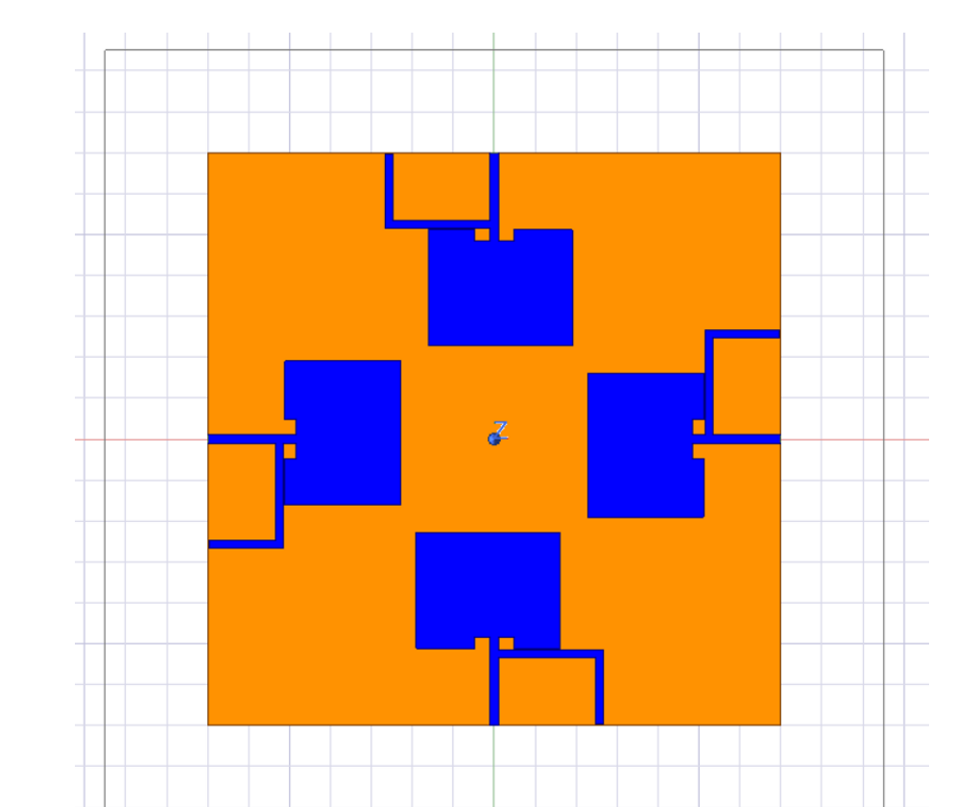
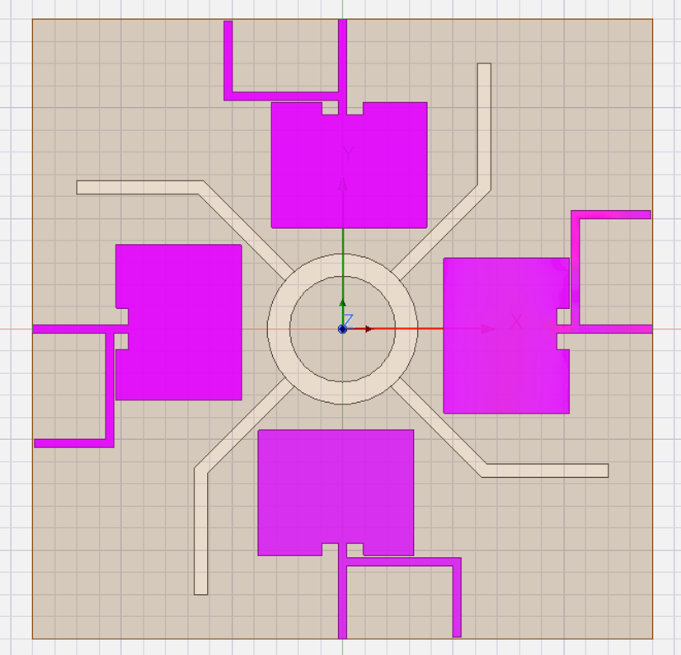
ANTENNA DESIGN & DESIGN SPECIFICATIONS
Antenna Design & Design Specifications
Geometry of the 4-port array
Key geometric parameters (Table I)
Substrate (W × L) | 120 × 120 mm
Substrate, εr(dielectric constant) (FR4) | h = 1.6 mm, 4.4
Patch (WP × LP) | 28.0 × 26.5 mm
Feed line WF / Stub Lstub | 3.0 / 34.5 mm
Ring Rout / Rin / DGS Wdgs | 12.0 / 8.0 / 2.0 mm
Front side — 4-port orthogonal array
(Back side) Ground plane — central DGS network
Four identical patch elements, each with an inverted-L feed stub
Circular ring coupled to 4 diagonal DGS branches for isolation
03 / 07

Slide 4
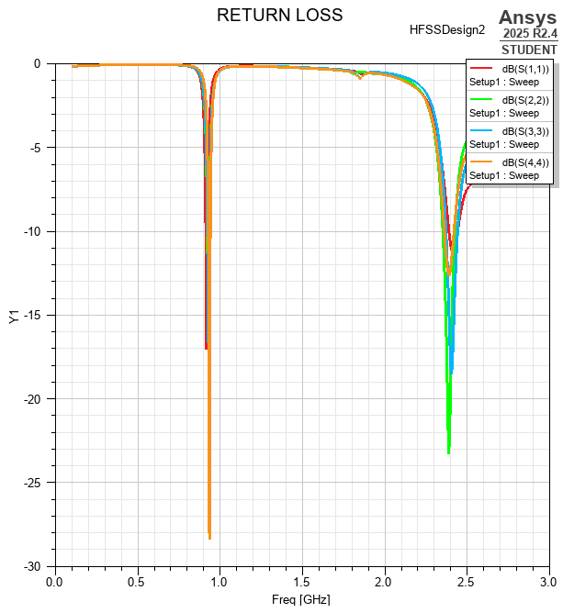
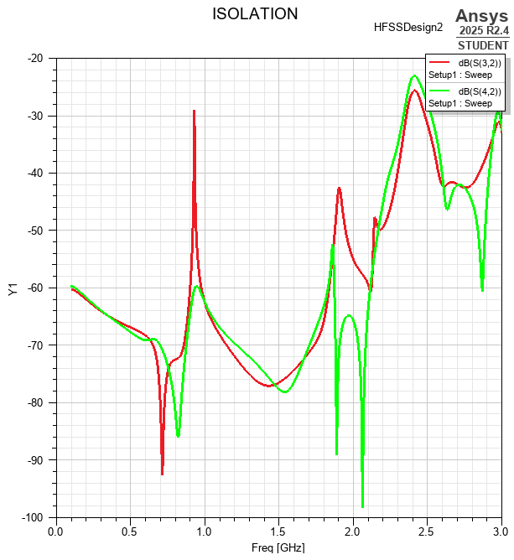
RESULTS & TABULATION · I
Results & Tabulation · I
Impedance matching & port isolation
0.915 GHz
Return loss: -28.2 dB
Isolation: -29.5 dB
Bandwidth: 35 MHz
2.400 GHz
Return loss: -23.4 dB
Isolation: -25.8 dB
Bandwidth: 180 MHz
Fig. 4 — Reflection coefficients
Fig. 5 — Inter-port isolation
Simulated S-parameter summary at target frequencies (Table II) — isolation remains below -25 dB across both bands, with notches reaching -90 dB near 0.75 GHz and 2.05 GHz.
04 / 07

Slide 5
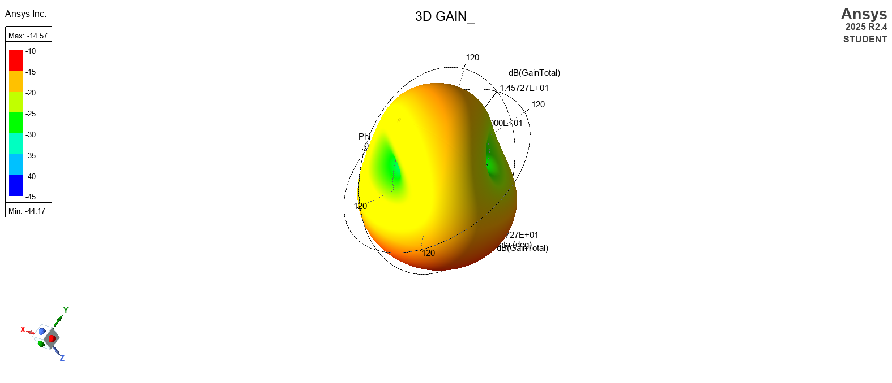
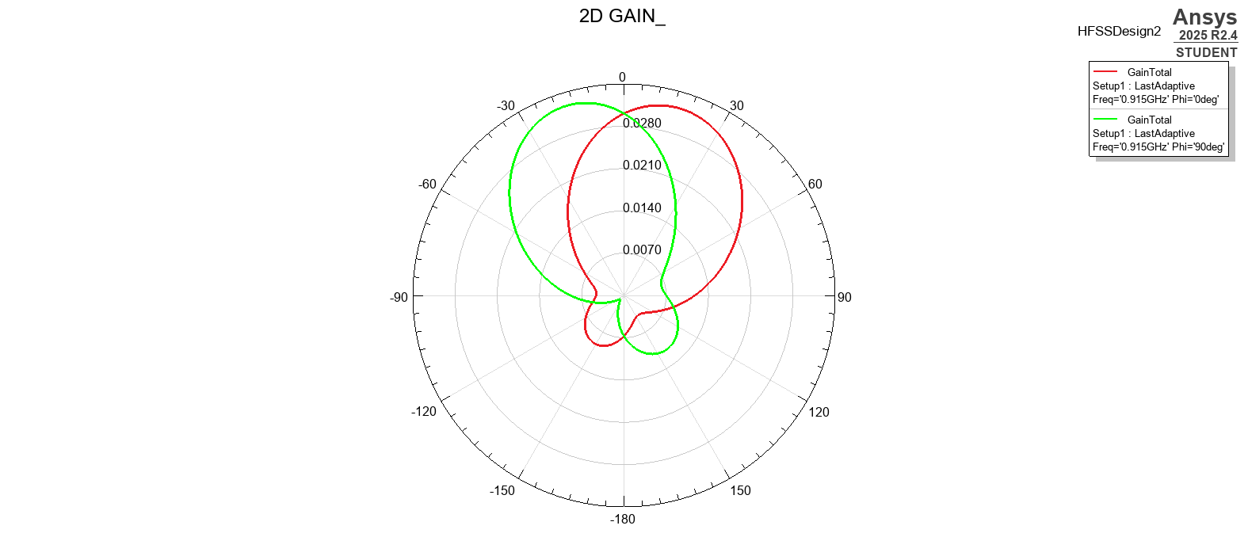
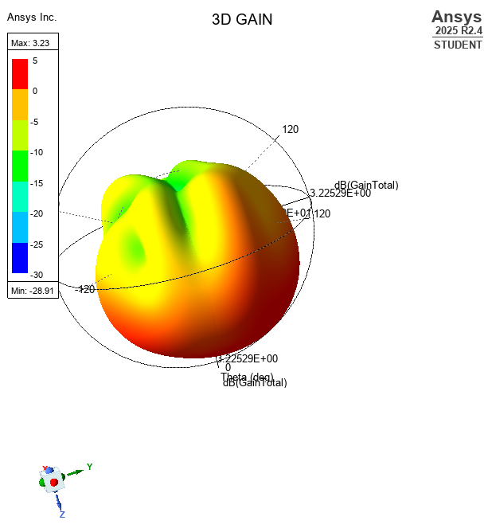
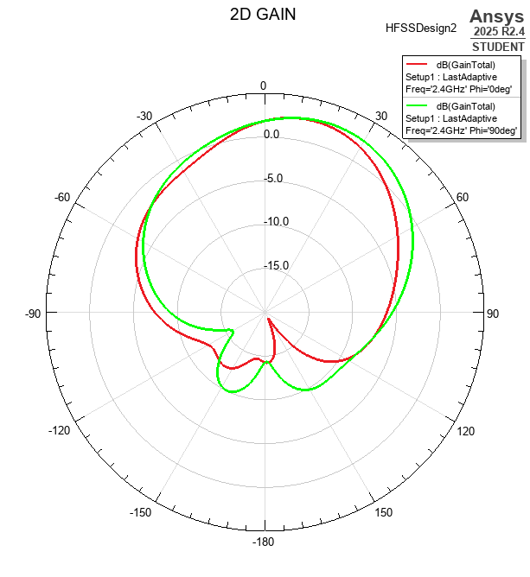
RESULTS & TABULATION · II
Results & Tabulation · II
Radiation pattern & realized gain
0.915 GHz — Sub-GHz band (Fig. 6, 7)
2.4 GHz — WLAN band (Fig. 8, 9)
Peak gain ≈ -14.6 dBi · broad, hemispherical broadside coverage
Peak gain ≈ 3.23 dBi · stable directive lobes, no pattern degradation between elements
05 / 07

Slide 6
APPLICATIONS
Applications
Where this design fits
Dual-band coverage plus 4-port isolation make this array a natural fit for compact, multi-service MIMO platforms.
V2X Communication Modules — Sub-GHz link paired with 2.4 GHz WLAN for vehicle-to-everything connectivity
IoT Gateways & LoRa Nodes — Long-range Sub-GHz telemetry alongside local Wi-Fi/Bluetooth backhaul
Smart Metering & Telemetry — Low-power long-range sensing combined with high-throughput local control
MIMO Access Points / CPE — Four isolated ports enable spatial diversity in multi-band wireless terminals
Automotive Telematics / RSU — DGS decoupling drawn from V2X MIMO literature suits compact automotive units
06 / 07

Slide 7
Conclusion
A compact, high-isolation platform for multi-band connectivity
A dual-band 4-port MIMO antenna array operating at 915 MHz and 2.4 GHz has been designed and simulated. Inverted-L feed stubs enable dual-frequency
resonance, while a central circular-ring DGS network with four diagonal branches suppresses mutual coupling across the array.
GAIN:- ISOLATION
0.915 GHZ 2.4GHZ 0.915 GHZ 2.4GHZ
Peak gain ≈ -14.6 dBi Peak gain ≈ 3.23 dBi solation: -29.5 dB Isolation: -25.8 dB
Stable radiation profiles across both bands make the design well suited to multi-band wireless terminals and V2X / IoT platforms.
07 / 07

